Slide 1

Stock market data analysis and close price prediction for renewable energy companies
By Group no. 6

Slide 2
Team members: Deepthi Raj Kokkeragadda Sana Shaikh Sejal Singh Kunduru Viswanatha Reddy Shaheen Begum Ashish Bharat Shinde
Mentor – Karthik Muskula

Slide 3
Business Objective:
To identify purchasing and selling patterns of 4 different company stocks
by analysing the close price of the stocks and to predict the future close price.

Slide 4
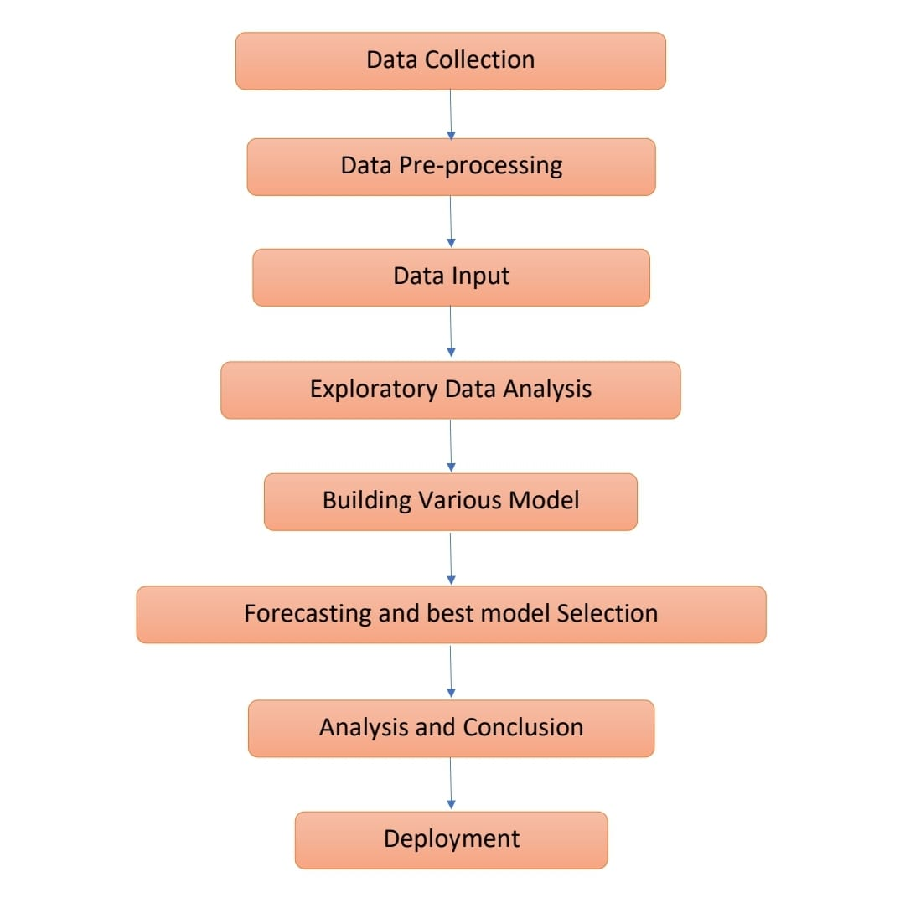
Project flow

Slide 5
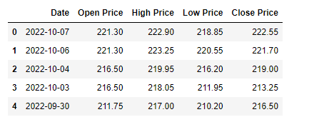
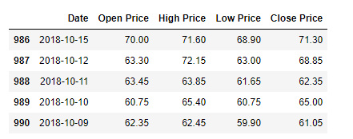
Exploratory Data Analysis
Data Set details:
4 companies, namely TATA power, BOROSIL renewable energy, Power grid corp. and JSW energy for 5 years.
The 5 columns being Date, Open price, high price, low price, close price.

Slide 6
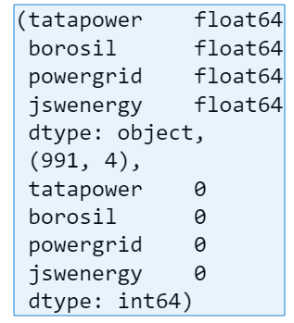
Data Set details:
Data of each company consists of 991 entries and 5 columns with no null values and duplicate values.
Data of each company consists of one Datetime column and the rest four are numerical columns.

Slide 7
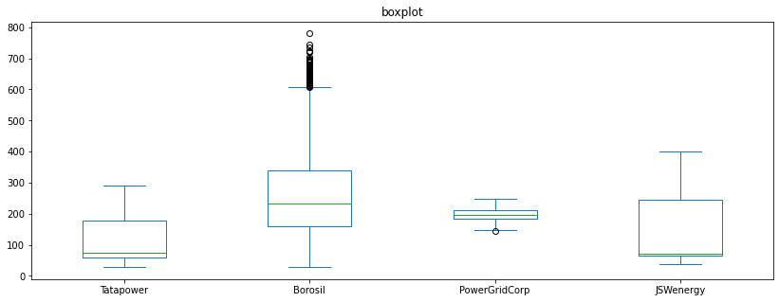
Outliers:
We can observe from the boxplots that BOROSIL data and Power grid corp data have some outliers .

Slide 8
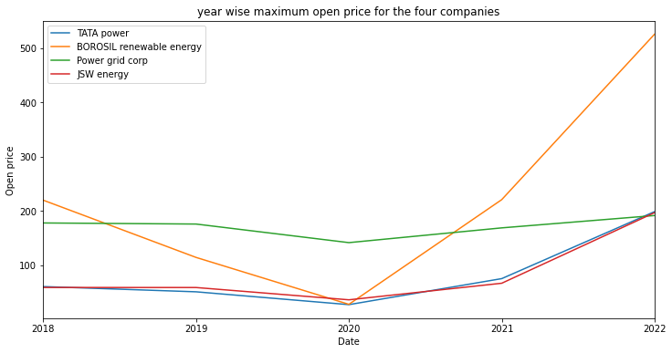

Open Price:
Date | tatapower | power grid | borosil | jswenergy
2018-10-09 | 60.75 | 178.00 | 220.0 | 59.10
2019-01-01 | 51.10 | 176.00 | 114.5 | 59.00
2020-01-01 | 27.45 | 141.75 | 28.0 | 36.35
2021-01-01 | 75.40 | 168.95 | 221.0 | 66.90
2022-01-03 | 198.90 | 191.70 | 526.0 | 197.00

Slide 9
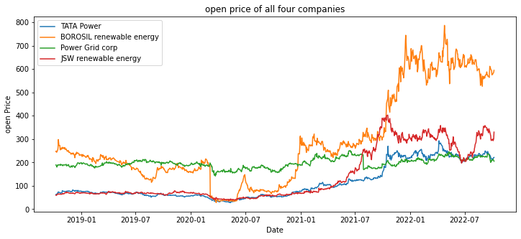
In all the five years we see that BOROSIL renewable energy has the maximum open price followed by JSW energy, Power grid corp and TATA power.
In 2018 we see that JSW energy has the lowest open price, in 2019 and 2020 TATA power has lowest open price, in 2021 JSW energy and in 2022 lowest open price is observed for Power grid corp.

Slide 10
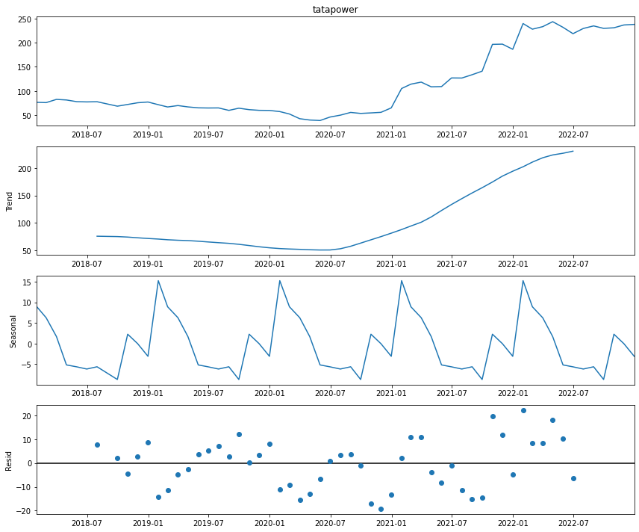
Close Price:
It can be observed that the Close Price of TATA Power follows a slow upward trend and we can observe some seasonality, mostly monthly seasonality.

Slide 11
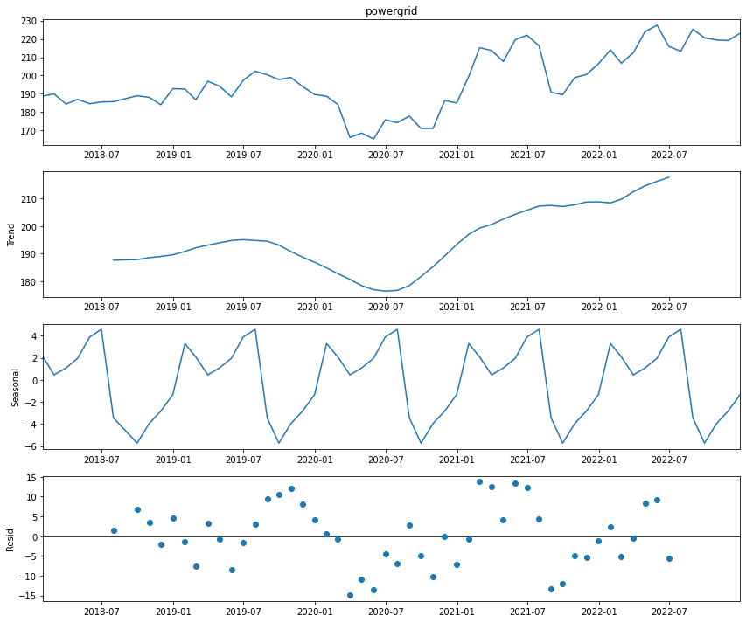
It can be observed that the Close Price of Power Grid corporation follows an uneven trend and we can observe some slight seasonality but it is not very prominent.

Slide 12
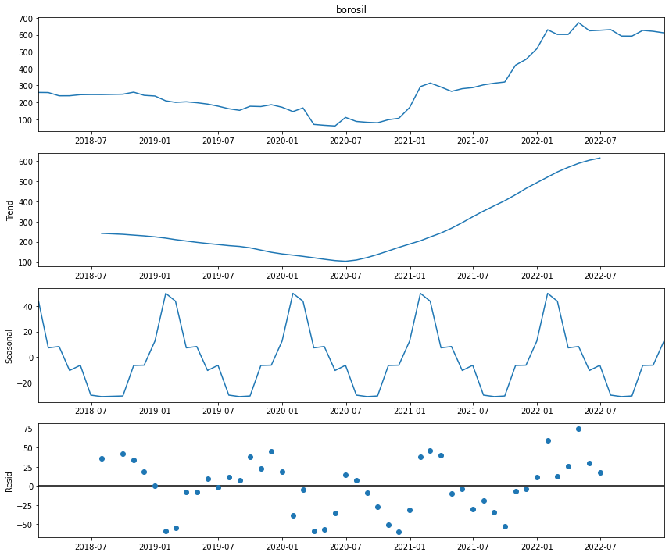
It can be observed that the Close Price of BORORSIL renewable energy follows an uneven trend and we can observe some monthly seasonality.

Slide 13
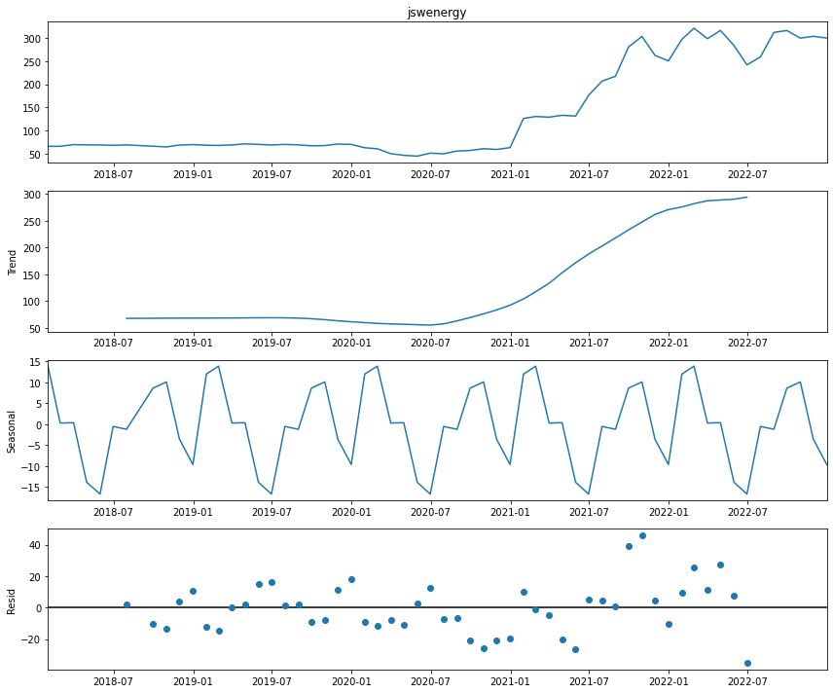
It can be observed that the Close Price of JSW energy follows an upward trend and we can observe prominent monthly seasonality.

Slide 14
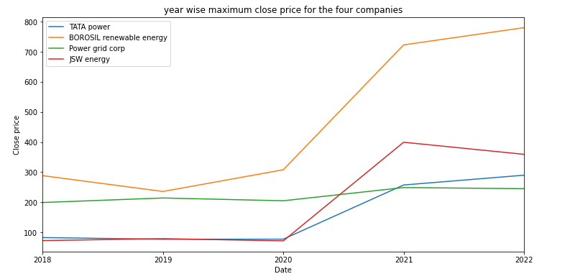
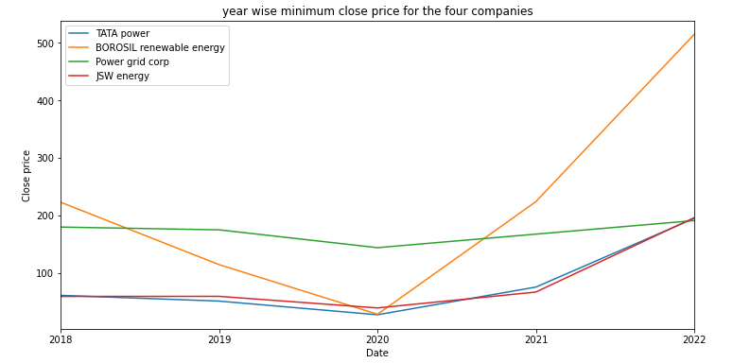
Date | tatapower | borosil | powergrid | jswenergy
2018-12-31 | 82.50 | 288.30 | 199.00 | 72.40
2019-12-31 | 76.85 | 235.70 | 214.05 | 78.80
2020-12-31 | 77.20 | 307.90 | 204.80 | 71.50
2021-12-31 | 257.25 | 722.85 | 248.70 | 399.35
2022-12-09 | 289.80 | 780.15 | 245.00 | 359.20

Slide 15
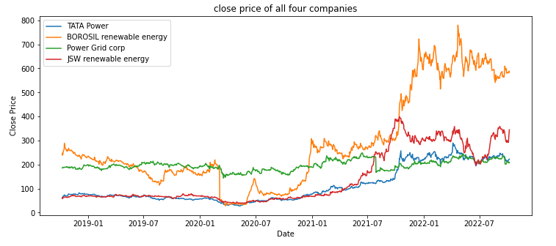
In all the five years maximum close price is observed by BOROSIL renewable energy followed by Power grid corp, JSW energy and TATA power.
In 2018 we see that JSW energy has the lowest close price, in 2019 and 2020 TATA power has lowest close price, in 2021 JSW energy and in 2022 lowest close price is observed for Power grid corp.

Slide 16
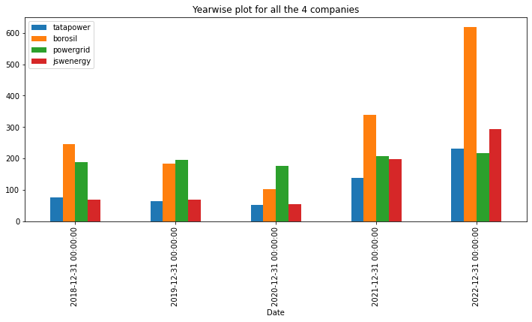
From the above yearly plot it is evident that the close price of Borosil renewable energy happens to lead followed by Poer grid corp and JSW energy.

Slide 17
Model Building
The different forecasting models implemented are as follows :
Naive Approach
Moving Average
Exponential Smoothing
Holt-Winter’s Model
ARIMA Model (Autoregressive Integrated Moving Average)
Prophet Model
LSTM Model (Long Short-Term Memory)

Slide 18
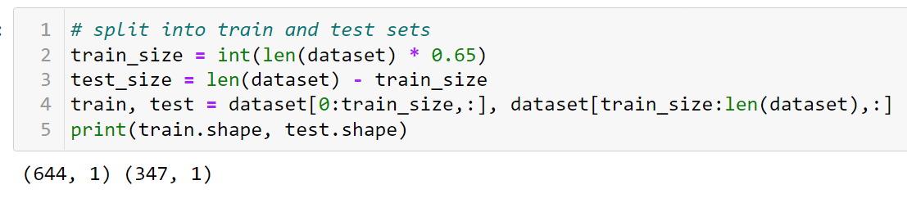
Data Partition details :
65:35 train, test split

Slide 19
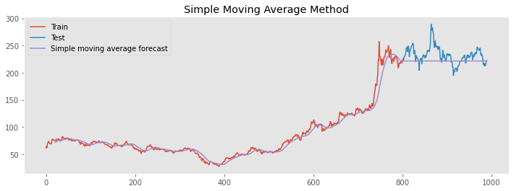
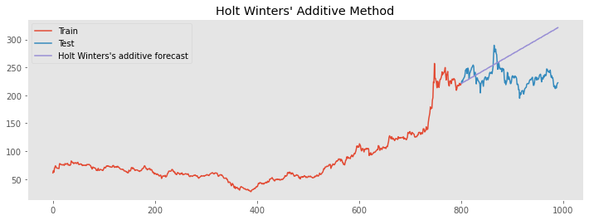
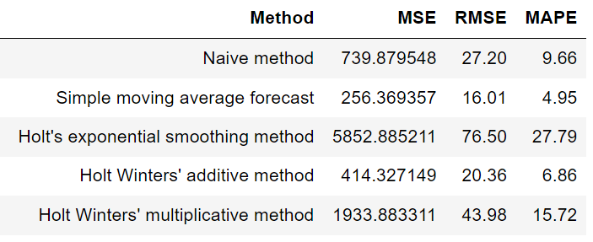
Moving average: Simple Moving average looks at the average of previous periods and assumes the next period will be in the range of that average.
The Holt-Winters model extends Holt to allow the forecasting of time series data that has both trend and seasonality, and this method includes this seasonality smoothing parameter, seasonality being additive or multiplicative.

Slide 20
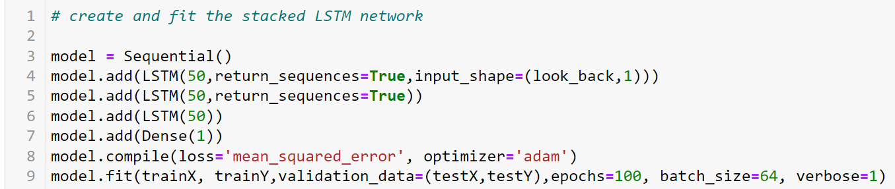
LSTM Model (Long Short-Term Memory) :
LSTM network is a type of recurrent neural network used in deep learning.
Recurrent neural networksthat learn to predict the future from sequences of variable lengths

Slide 21
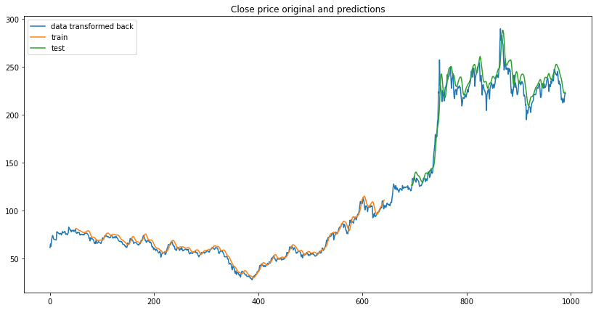
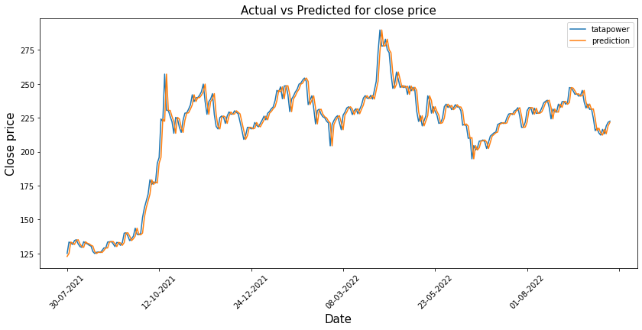
We used the LSTM model to find the prediction of stock price for 60 days.
LSTM has the least RMSE value hence is the best model.
The epochs was 100 and batch size was 64.

Slide 22
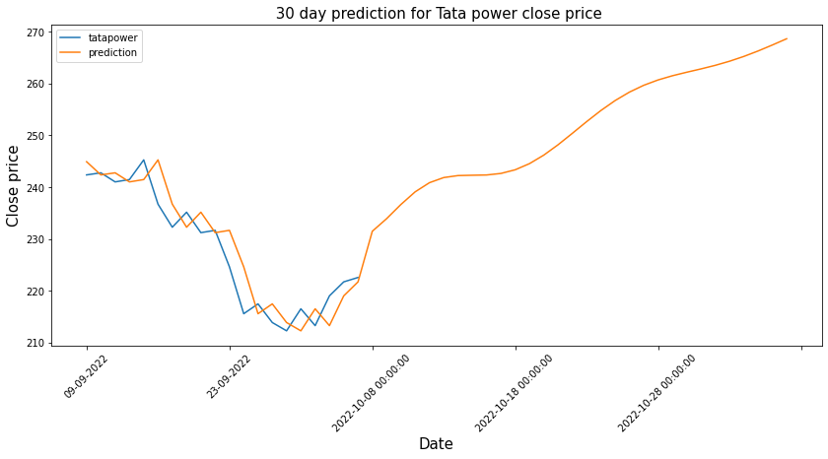
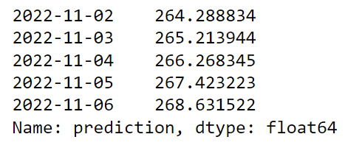
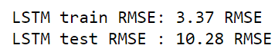

Slide 23
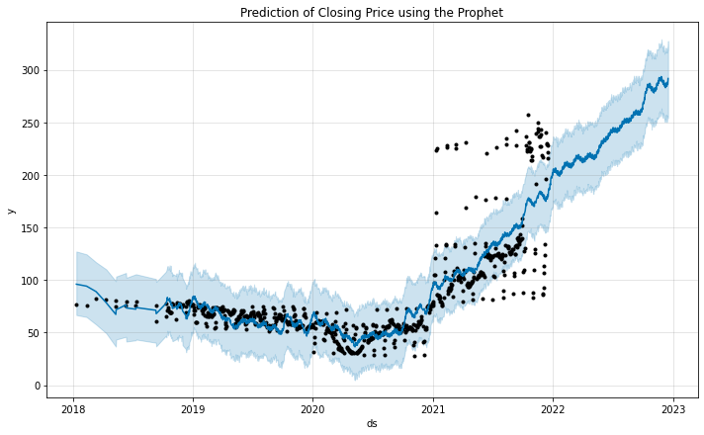
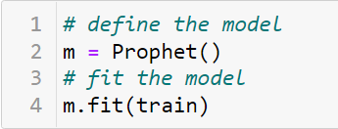
Prophet Model :
Prophet is a open source library developed by Facebook .
It is designed for automatic forecasting of univariant time series data.
Prophet is robust to missing data and shifts in the trend, and typically handles outliers well.

Slide 24
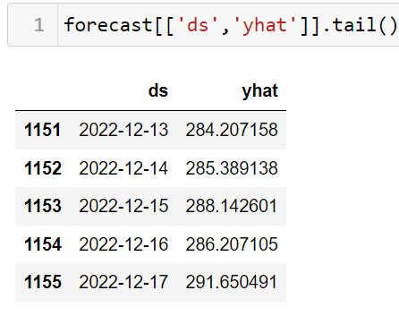
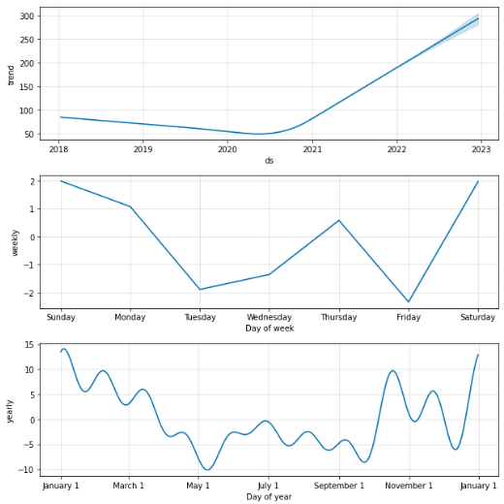
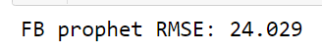

Slide 25
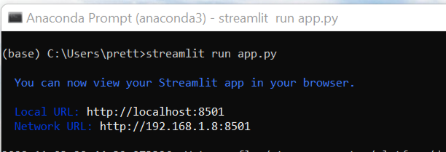
Deployment:
Streamlit is an open source app framework in Python language.
It helps us create web apps for data science and machine learning in a short span.
It is compatible with major Python libraries.
Streamlit-multipage web app enables you to add pages to your web app.
Heroku is a cloud platform as a service supporting several programming languages.
app · Streamlit (stock-prediction-web-app-1.herokuapp.com)

Slide 26
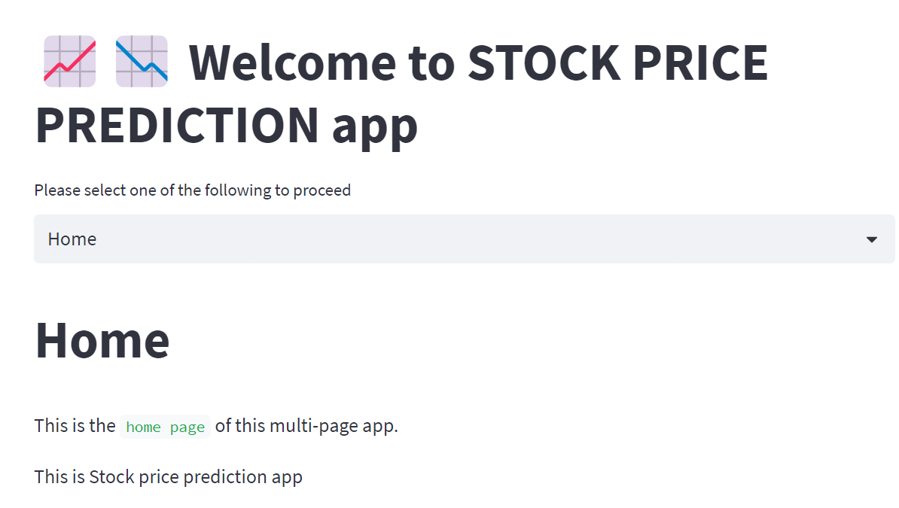
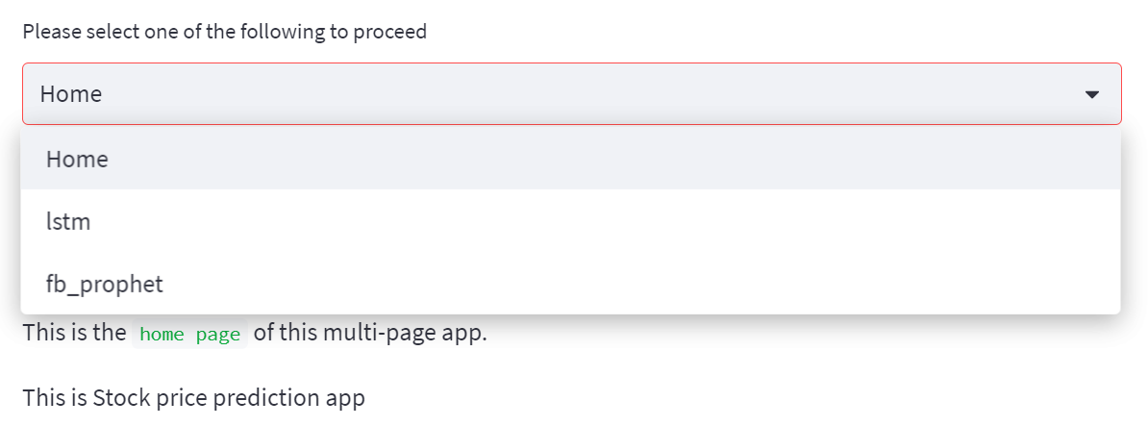
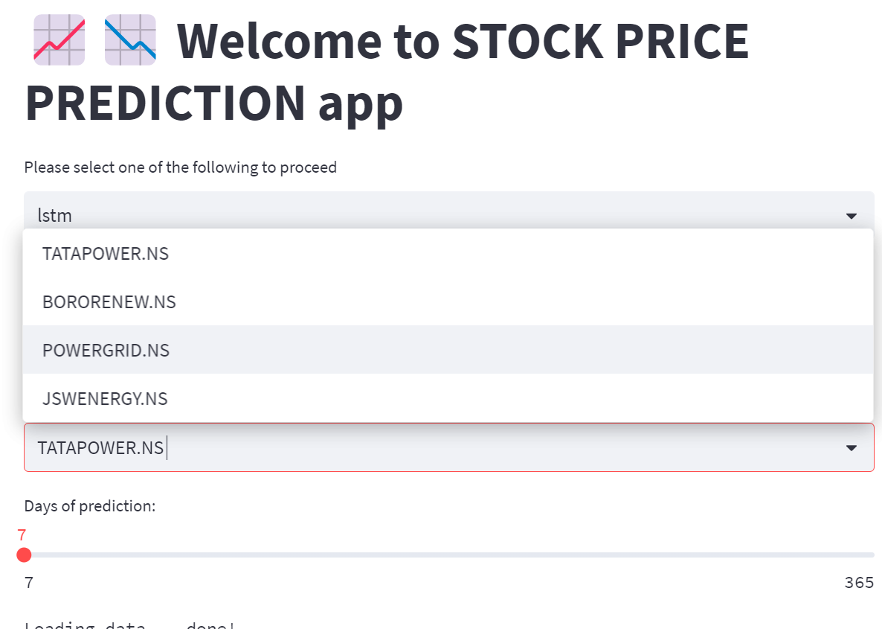
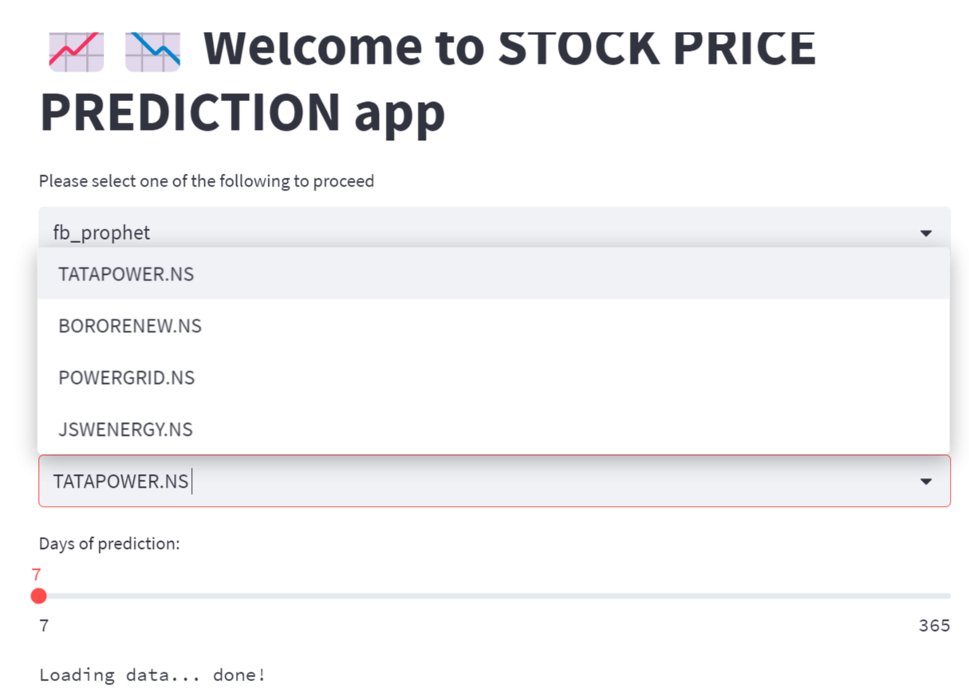

Slide 27
Challenges:
Data preparation for the model
Incompatibility to handle and forecast for multiple target columns
Most methods are demonstrated on simple univariate time series forecasting
Deployment of lstm on Heroku is complicated compared to Streamlit

Slide 28
THANK YOU!

